Slide 1


A lookahead approximation for the inbound purchasing inventory routing problem with perishable products (SD-IB-IRP-PP)
Ariel Rojas, Juan Manuel Betancourt,
Daniel Hernando Cuellar,
Marlin Ulmer,
Camilo Gómez, David Álvarez

Slide 2




Context and Motivation
The spread of e-commerce platforms and its benefits for small farmers
E-commerce platforms have disrupted both traditional business models and the supply chains that support them.
Small farmers have little or no distribution capacity, limiting their participation in competitive markets.
1

Slide 3


Context and Motivation
The spread of e-commerce platforms and its benefits for small farmers
E-commerce platforms have disrupted both traditional business models and the supply chains that support them.
Small farmers have little or no distribution capacity, limiting their participation in competitive markets.
1

Slide 4
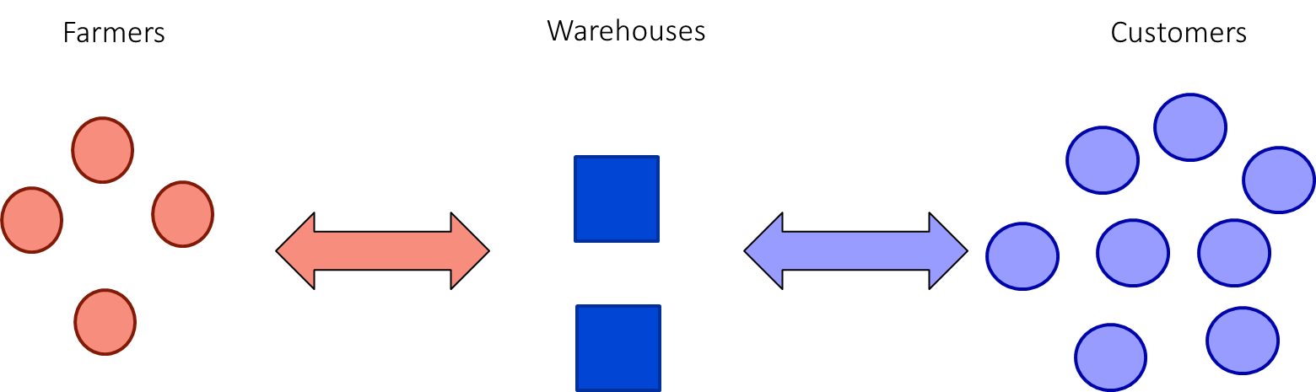
Context and Motivation
E-commerce platforms as bridges between producers and consumers
Two-echelon inventory routing problem summary
Two-echelon supply chain
Inbound Logistics – First Mile
2

Slide 5



Problem Definition
Suppliers - Farmers
Warehouse
Customers
1
2
3
4
Unknown customers demand and farmers supply for each product.
Known product prices, availability and perishability.
5
6
3

Slide 6



Problem Definition
Suppliers - Farmers
Warehouse
Customers
1
2
3
Decisions to make each day
4
How much to buy of each product and which suppliers to buy from.
5
6
3

Slide 7


Problem Definition
Suppliers - Farmers
Warehouse
Customers
1
2
3
Decisions to make each day
4
How much to buy of each product and which suppliers to buy from.
Routing strategy for replenishment.
5
6
3
Notes:
Dada la decision de reabastecimiento que tomamos, debemos definir la estrategia de ruteo que usaremos para realizar la compra a los agricultores. Debemos tener en cuenta que contamos con unos vehículos con capacidad limitada y cada proveedor puede ser visitado por solo una ruta

Slide 8




Problem Definition
Suppliers - Farmers
Warehouse
Customers
1
2
3
Decisions to make each day
4
How much to buy of each product and which suppliers to buy from.
Routing strategy for replenishment.
Demand compliance using available inventory.
5
6
3

Slide 9
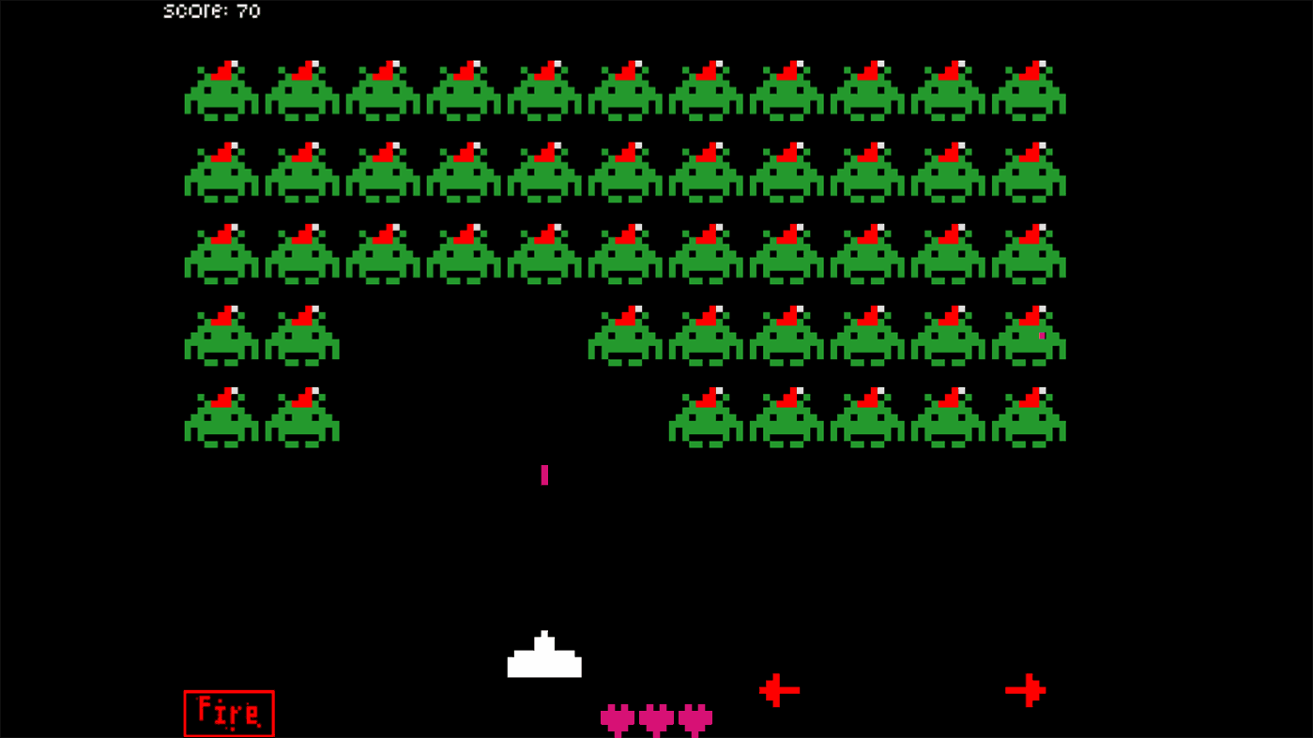
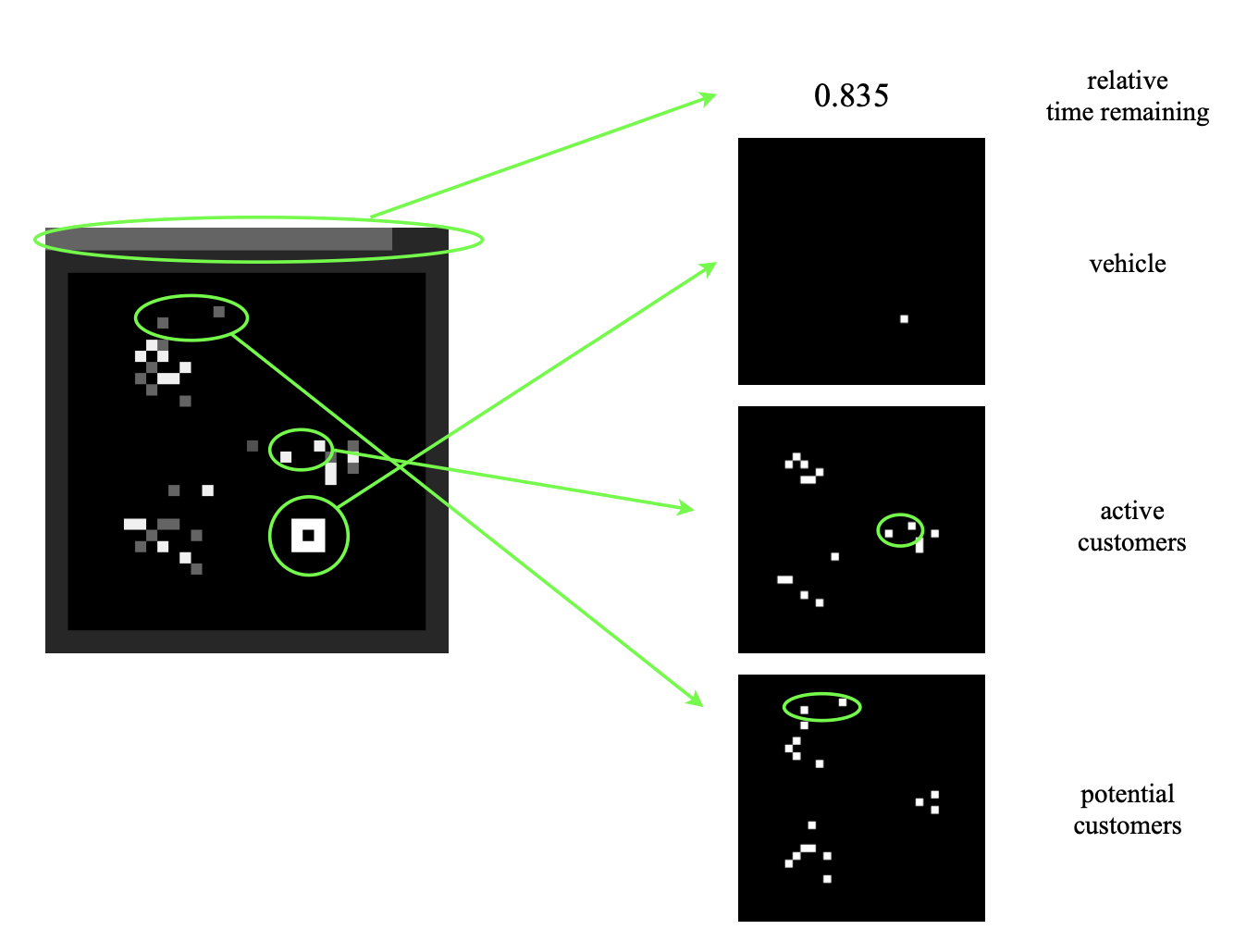
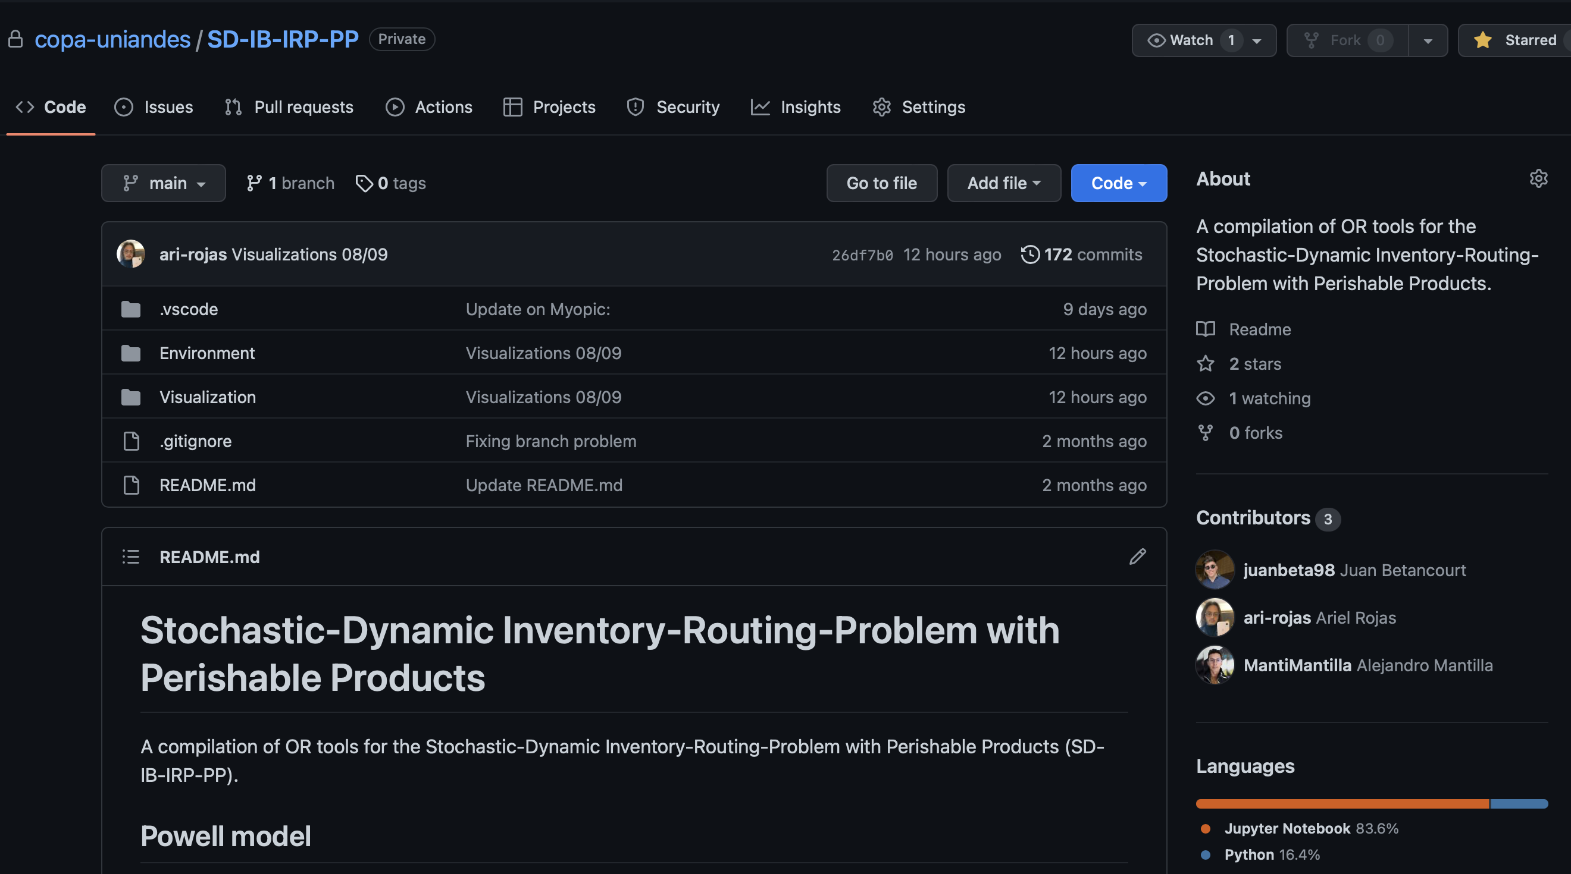
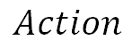
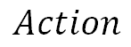
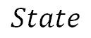
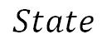
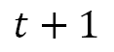
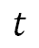
Problem Definition
Complexity on the system and actions. The system is dynamic and stochastic.
Unified framework for stochastic optimization
$$t$$
$$t+1$$
$$State$$
$$Action$$
$$State$$
$$Action$$
4
Notes:
El problema es complejo
Para conceptualizar todos estos components,
Propone un proceso de decision

Slide 10
Problem Definition
Goals of this presentation
Build a computational environment to model the SD-IB-IRP-PP.
Design a policy evaluation scheme that captures key metrics for the problem.
Execute a proof of concept for basic policies to test the environment, the policy evaluation scheme and the impact of including future information.
5

Slide 11

Problem Definition
Unified Stochastic Optimization Framework
States $(S_{t})$
Inventory levels
Deterministic information
Belief variables
6

Slide 12

Problem Definition
Unified Stochastic Optimization Framework
States $(S_{t})$
Actions $(X_{t})$
Inventory levels
Deterministic information
Belief variables
Procurement plan
Routing strategy
Inventory management
6

Slide 13
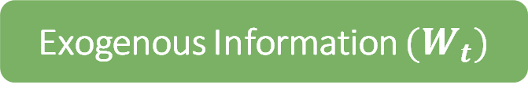
Problem Definition
Unified Stochastic Optimization Framework
States $(S_{t})$
Actions $(X_{t})$
Exogenous Information $(W_{t})$
Inventory levels
Deterministic information
Belief variables
Procurement plan
Routing strategy
Inventory management
Stochastic phenomena realizations:
Demand
Available quantities
6

Slide 14

Problem Definition
Unified Stochastic Optimization Framework
States $(S_{t})$
Actions $(X_{t})$
Exogenous Information $(W_{t})$
Inventory levels
Deterministic information
Belief variables
Procurement plan
Routing strategy
Inventory management
Stochastic phenomena realizations:
Demand
Available quantities
Transition Function $\left(S_{X}^{M}\left(S_{t},X_{t},W_{t}\right)\right)$
Stochastic, Perishable Inventory dynamics
Backorders
Deterministic & Beliefs update
6

Slide 15

Problem Definition
Unified Stochastic Optimization Framework
States $(S_{t})$
Actions $(X_{t})$
Exogenous Information $(W_{t})$
Inventory levels
Deterministic information
Belief variables
Procurement plan
Routing strategy
Inventory management
Stochastic phenomena realizations:
Demand
Available quantities
Cost Function $\left(R_{t}\left(S_{t},X_{t},W_{t}\right)\right)$
Purchase cost
Routing cost
Holding cost
Backorders cost
6

Slide 16
Python Environment
Computational implementation of the model: Environment
Computational tool: Python 3.10.4
Under OpenAI gym class
Simulates the system’s dynamics under the Decision Process Model
Emulates the transition and reward functions
7

Slide 17
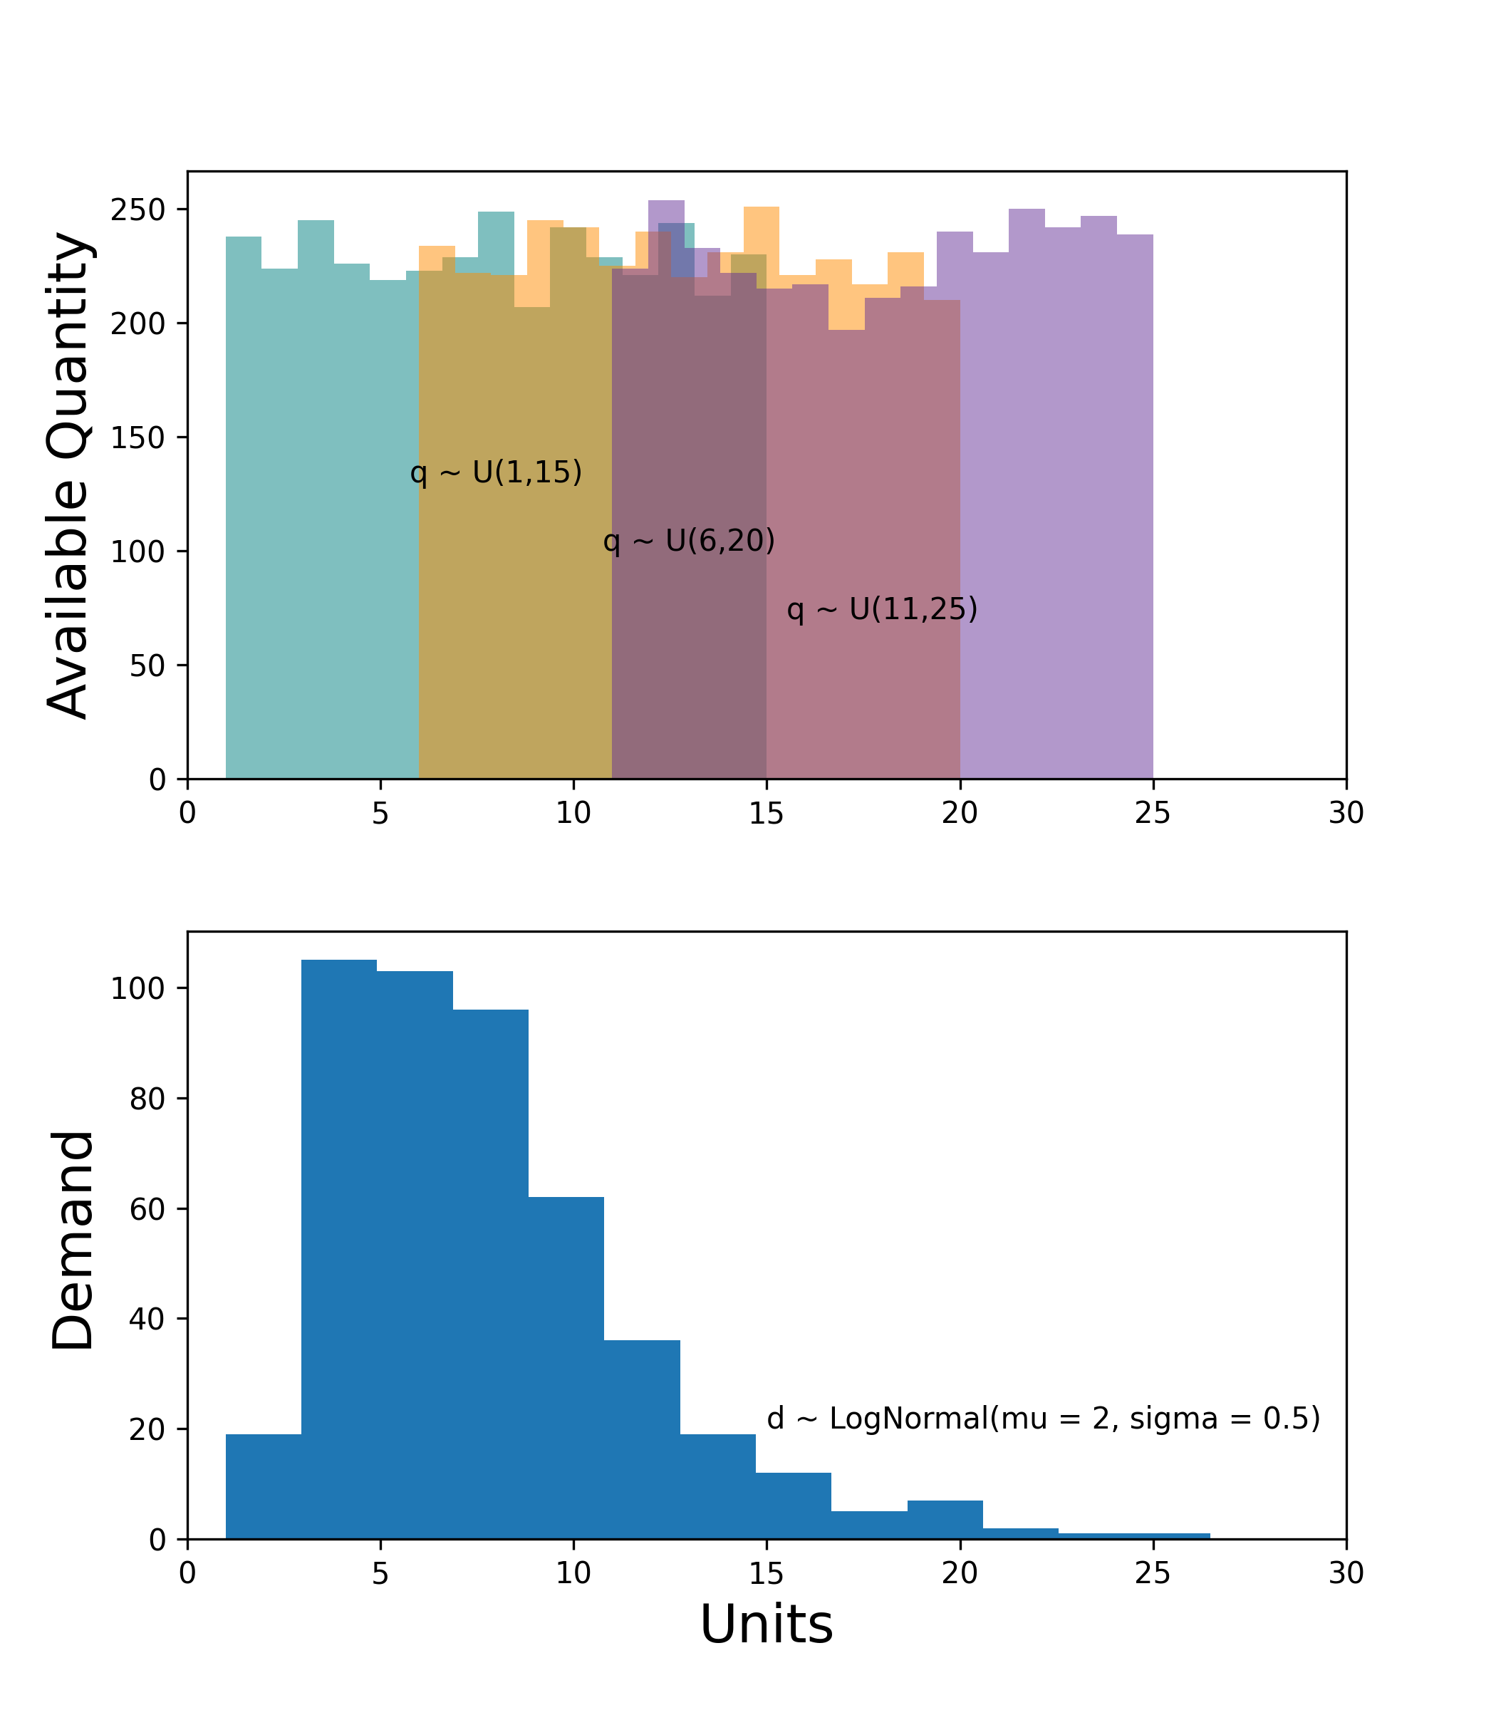
Python Environment
Environment main aspects
Complete instance generation
Parameters’ distributions
Expected service level analysis
Replicability
Facilitates experimenting on the system
Decision Analytics
8

Slide 18
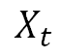
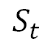
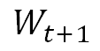
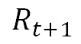
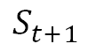
Python Environment
Environment main aspects
Policy Evaluation
Complete instance generation
Instance generator
$$W_{t+1}$$
Environment
$$S_{t+1}$$
Facilitates experimenting on the system
$$R_{t+1}$$
$$X_{t}$$
$$S_{t}$$
Decision Analytics
Policy / Agent
8

Slide 19
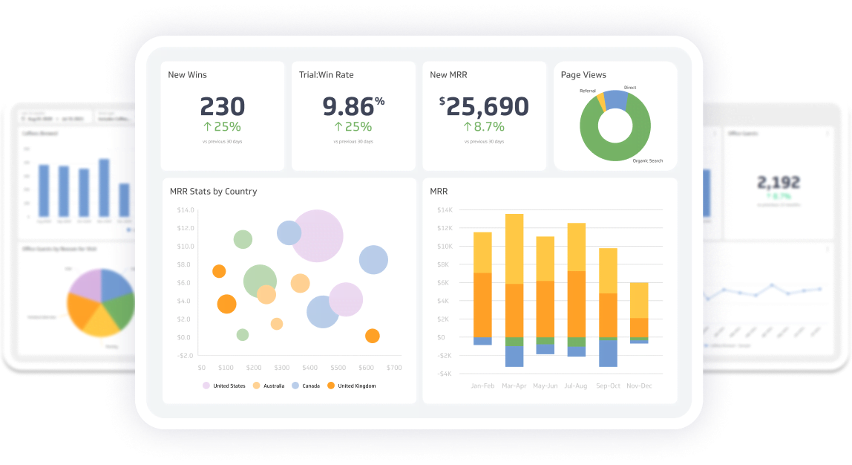
Python Environment
Environment main aspects
Complete instance generation
Policy Evaluation
Facilitates experimenting on the system
Decision Analytics
8

Slide 20
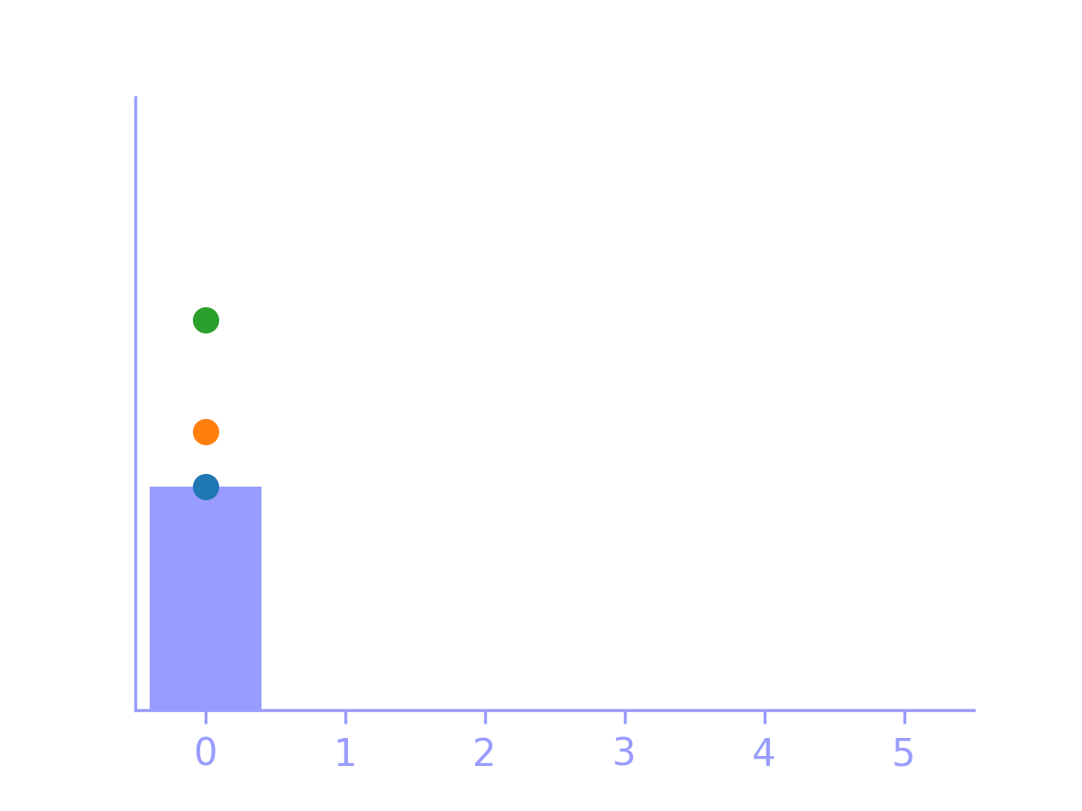



Solution Approaches
Policy 1: Myopic heuristic
Purchase
Routing
Inventory Management
Estimates the stochastic parameters for today.
Buys the expected demand based on estimates.
Route-first cluster-second heuristic (Prins, 2004)
Doesn’t account for final inventory in next time period
9

Slide 21
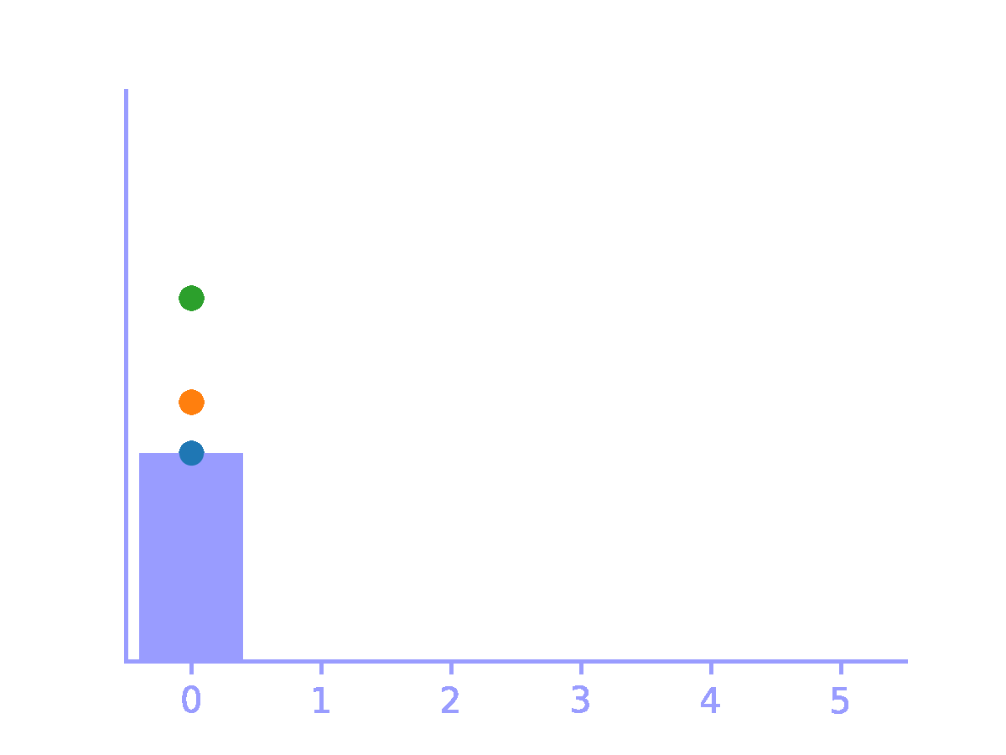
Solution Approaches
Policy 1: Myopic heuristic
Purchase
Routing
Inventory Management
Estimates the stochastic parameters for today.
Buys the expected demand based on estimates.
Route-first cluster-second heuristic (Prins, 2004)
Doesn’t account for final inventory in next time period
9

Slide 22
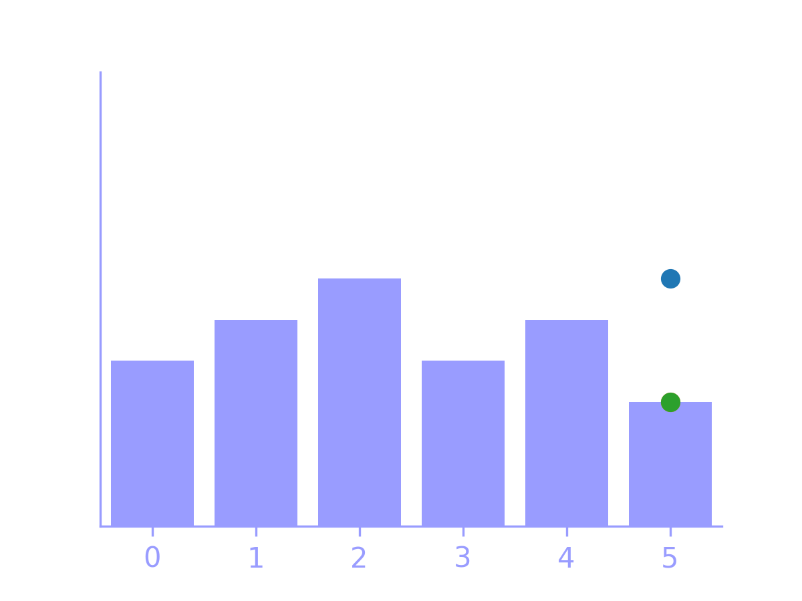
Solution Approaches
Policy 1: Myopic heuristic
Purchase
Routing
Inventory Management
Estimates the stochastic parameters for today.
Buys the expected demand based on estimates.
Route-first cluster-second heuristic (Prins, 2004)
Doesn’t account for final inventory in next time period
9

Slide 23
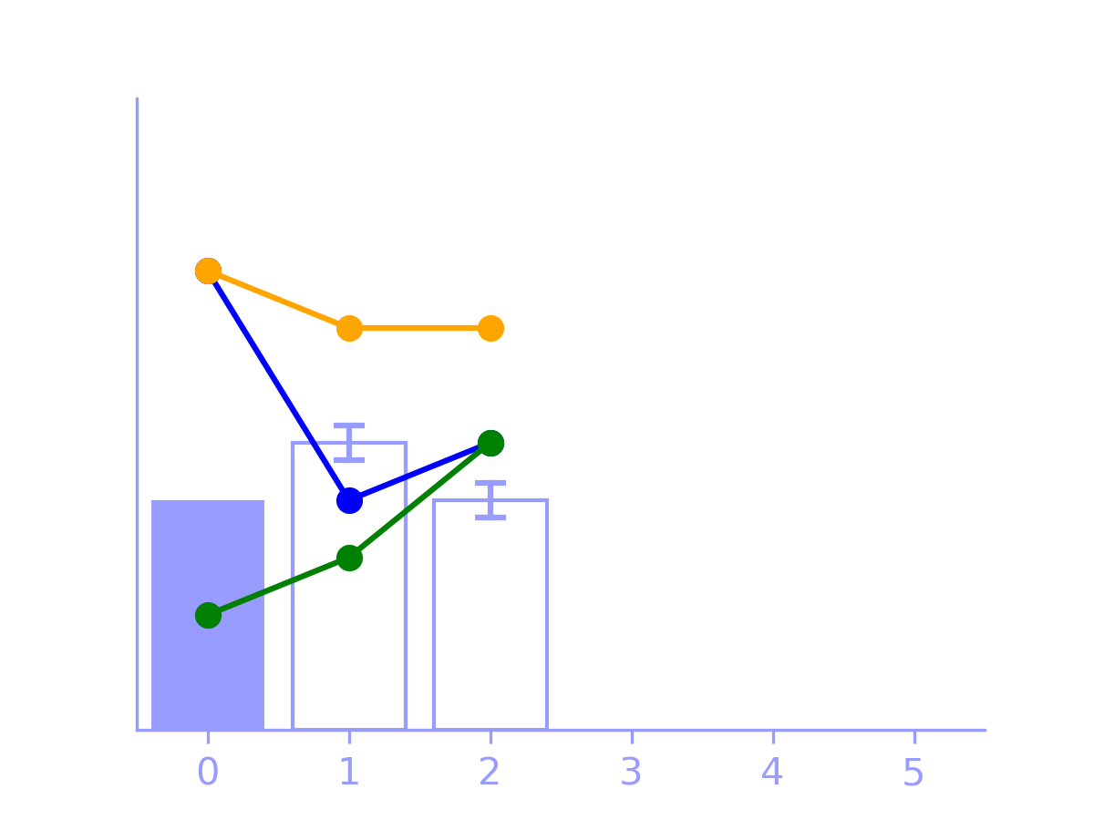
Solution Approaches
Policy 2: Stochastic Rolling Horizon
Purchase
Estimates the stochastic parameters for today and a lookahead horizon.
MIP decides replenishment.
10

Slide 24
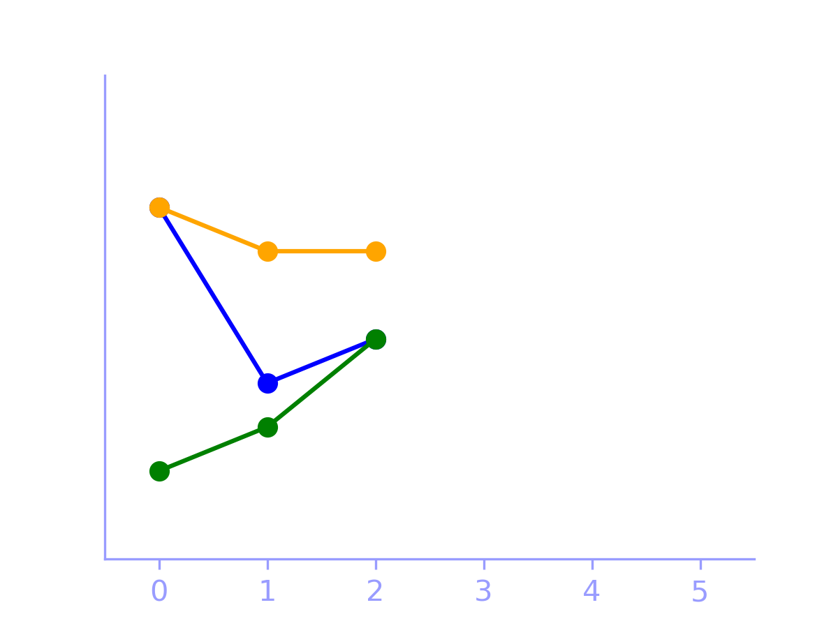
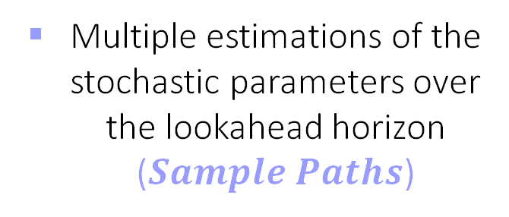
Solution Approaches
Policy 2: Stochastic Rolling Horizon
Purchase
Estimates the stochastic parameters for today and a lookahead horizon.
MIP decides replenishment.
Multiple estimations of the stochastic parameters over the lookahead horizon ($Sample Paths$)
10

Slide 25
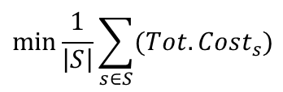
Solution Approaches
Policy 2: Stochastic Rolling Horizon
Purchase
Decision Variables
Estimates the stochastic parameters for today and a lookahead horizon.
MIP decides replenishment.
How much to buy of each product and who to buy it from
Inventory and backorders accounting
Objective Function
$$\min{\frac{1}{\left|S\right|}\sum_{s∈S}{(Tot.Cost_{s})}}$$
10

Slide 26
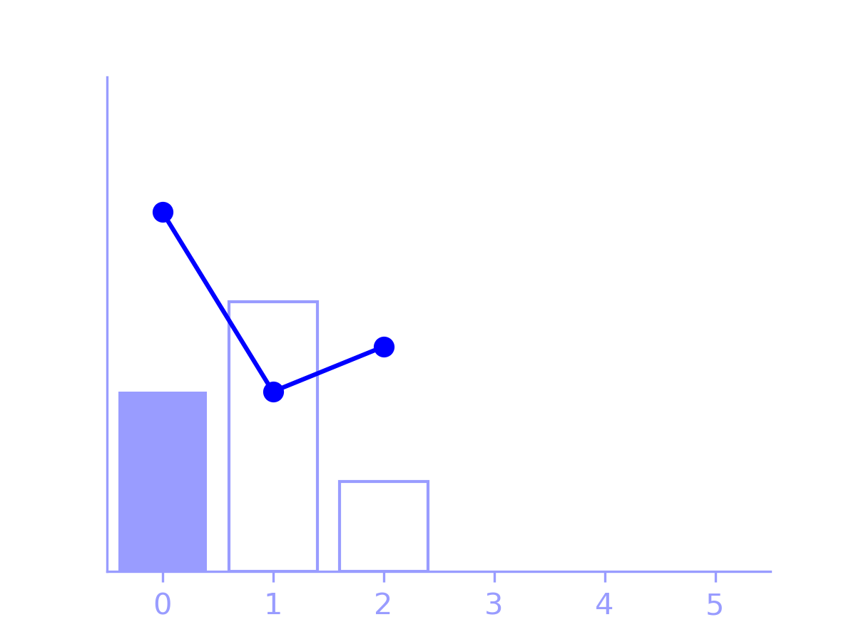
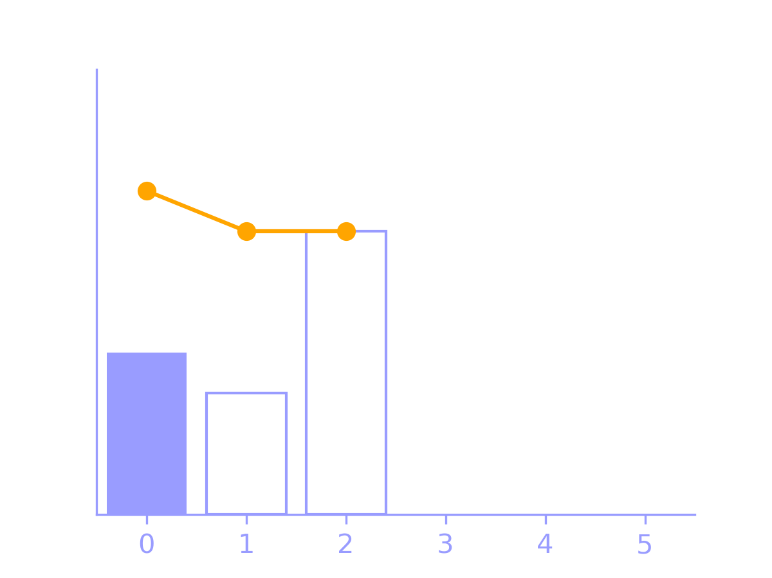
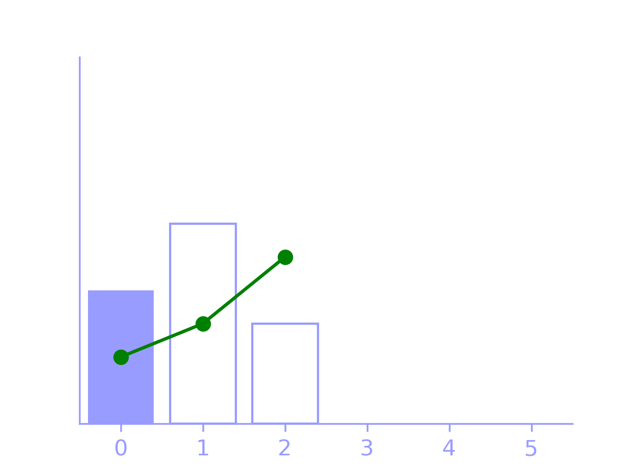
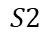
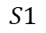
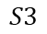
Solution Approaches
Policy 2: Stochastic Rolling Horizon
Purchase
Decision Variables
Estimates the stochastic parameters for today and a lookahead horizon.
MIP decides replenishment.
How much to buy of each product and who to buy it from
Inventory and backorders accounting
$$S1$$
$$S2$$
Objective Function
$$\min{\frac{1}{\left|S\right|}\sum_{s∈S}{(Tot.Cost_{s})}}$$
$$S3$$
10

Slide 27

Solution Approaches
Policy 2: Stochastic Rolling Horizon
Purchase
Non-anticipativity constraint for purchase variable to ensure a single decision on current period
Estimates the stochastic parameters for today and a lookahead horizon.
MIP decides replenishment.
$$S1$$
$$S2$$
$$S3$$
10

Slide 28
Solution Approaches
Policy 2: Stochastic Rolling Horizon
Purchase
Estimates the stochastic parameters for today and a lookahead horizon.
MIP decides replenishment.
10

Slide 29
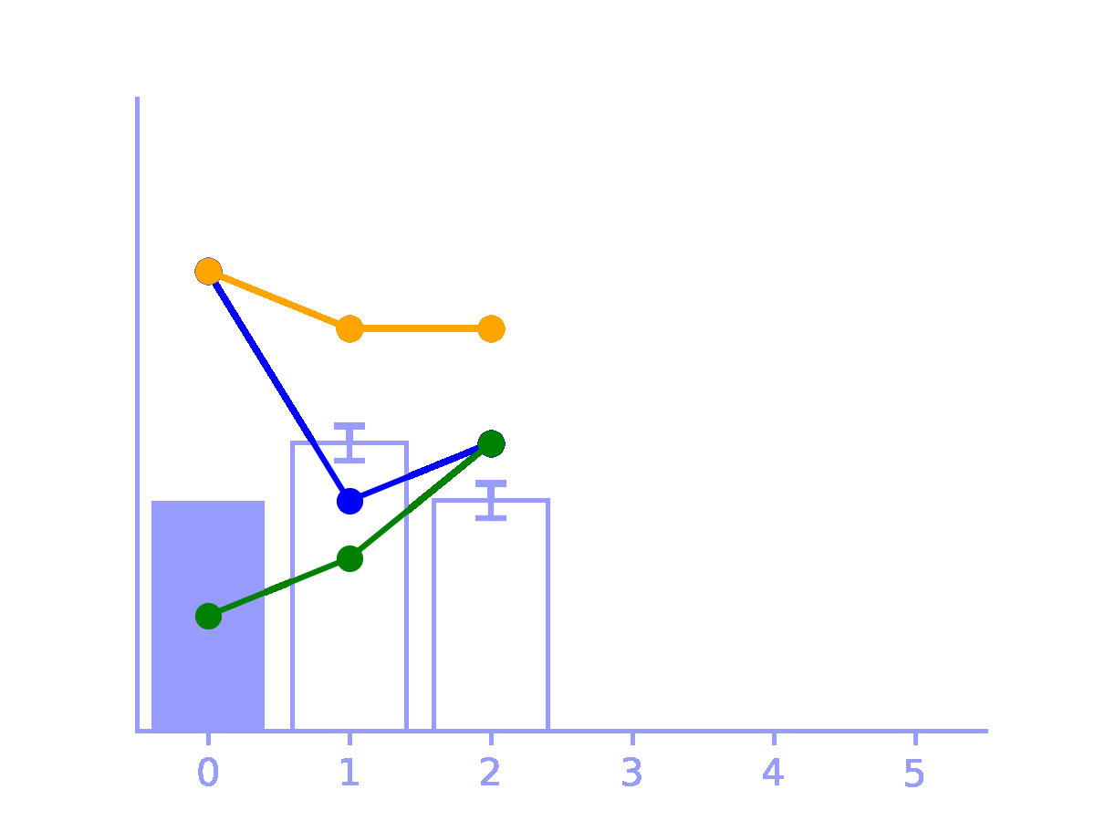
Solution Approaches
Policy 2: Stochastic Rolling Horizon
Purchase
Estimates the stochastic parameters for today and a lookahead horizon.
MIP decides replenishment.
10

Slide 30
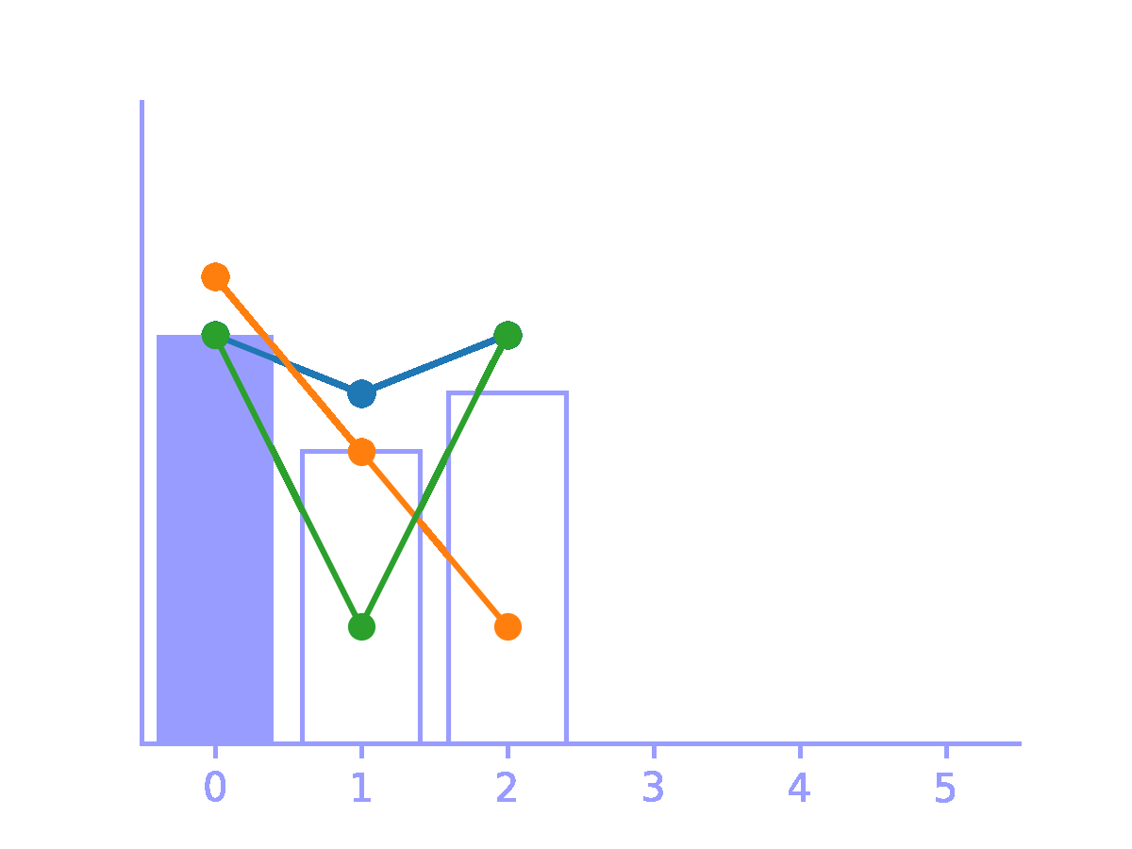

Solution Approaches
Policy 2: Stochastic Rolling Horizon
Purchase
Routing
Inventory Management
Estimates the stochastic parameters for today and a lookahead horizon.
MIP decides replenishment.
Route-first cluster-second heuristic (Prins, 2004)
Prioritizes oldest available inventory for demand compliance.
10

Slide 31
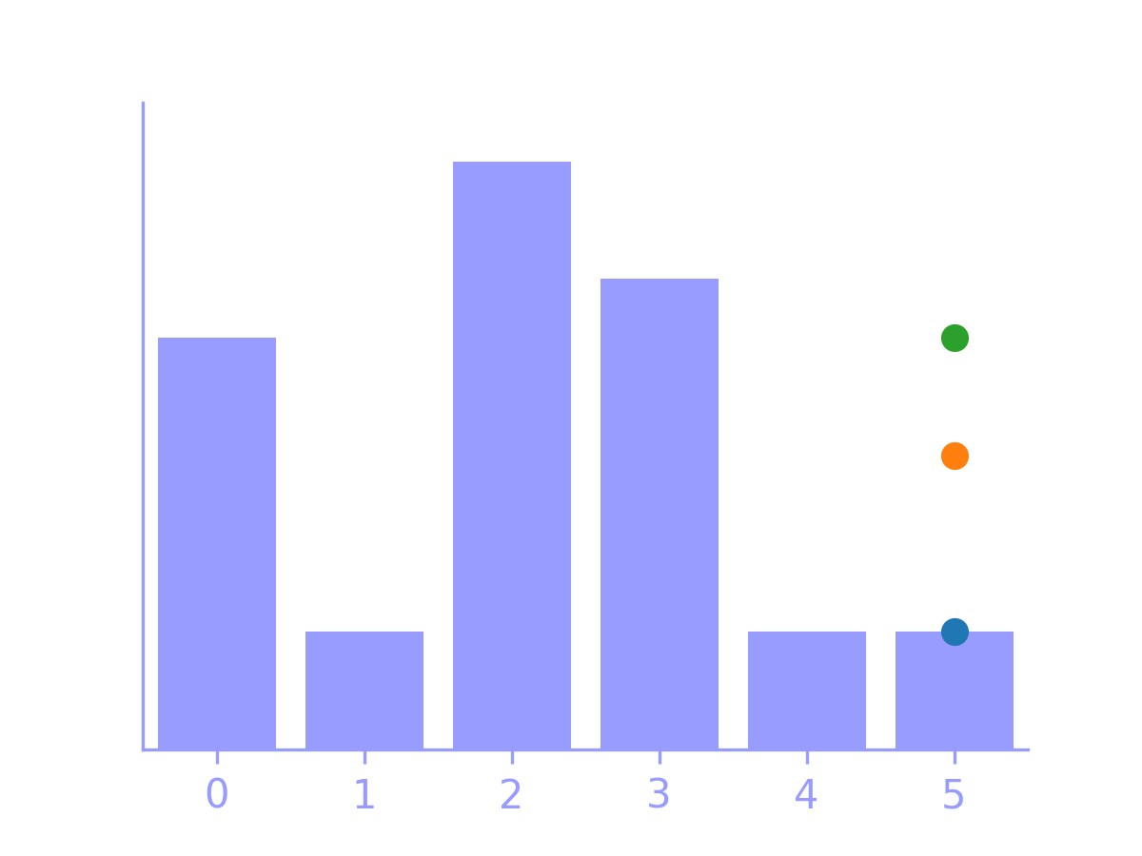
Solution Approaches
Policy 2: Stochastic Rolling Horizon
Purchase
Routing
Inventory Management
Estimates the stochastic parameters for today and a lookahead horizon.
MIP decides replenishment.
Route-first cluster-second heuristic (Prins, 2004)
Prioritizes oldest available inventory for demand compliance.
10

Slide 32
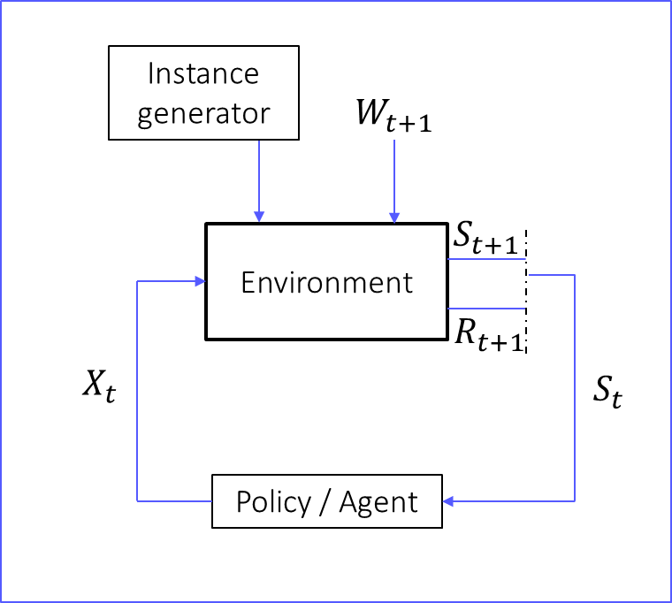
Solution Approaches
Policy Evaluation
Stochastic RH
Myopic
Quantity
Total Cost
Backorders
Subset of suppliers
11

Slide 34
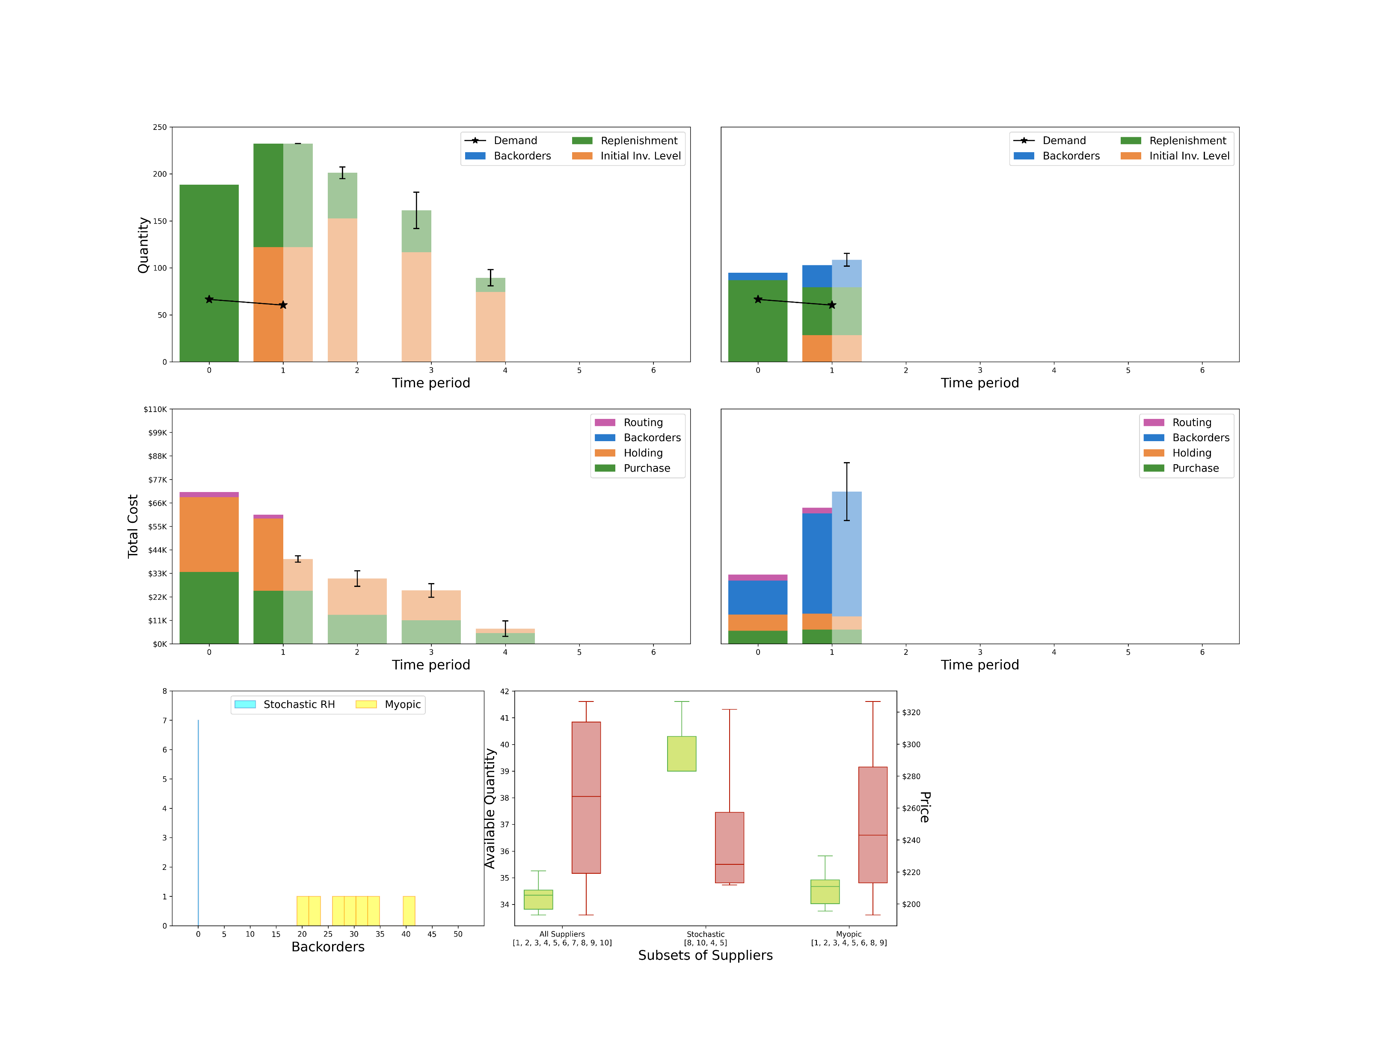
Solution Approaches
Policy Evaluation
One-on-one comparison between policies’ decisions
Stochastic RH
Myopic
Past realized decisions and costs
Quantity
Total Cost
12

Slide 35
Solution Approaches
Policy Evaluation
One-on-one comparison between policies’ decisions
Stochastic RH
Myopic
Past realized decisions and costs
Today’s initial expected decisions and realized decisions and costs
Quantity
Total Cost
12

Slide 36
Solution Approaches
Policy Evaluation
One-on-one comparison between policies’ decisions
Stochastic RH
Myopic
Past realized decisions and costs
Today’s initial expected decisions and realized decisions and costs
Stochastic RH lookahead expected decisions
Quantity
Total Cost
12

Slide 37
Solution Approaches
Policy Evaluation
One-on-one comparison between policies’ decisions
Backorders
Subset of suppliers
13

Slide 38
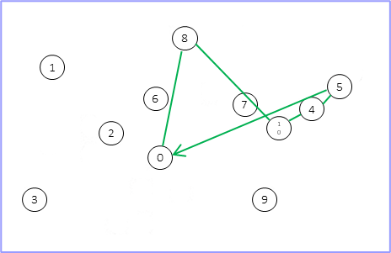
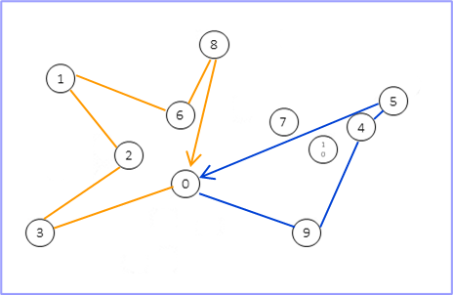
Solution Approaches
Policy Evaluation
One-on-one comparison between policies’ decisions
Backorders
Subset of suppliers
13

Slide 39
Results
Performance Metrics
Objective Function
Total Cost
14

Slide 40
Results
Performance Metrics
Objective Function
Total Cost
Impact of uncertainty on decisions
Customer’s Service Level
Perished products
Computational burden
Execution time
14

Slide 41
Results
Performance Metrics
Experimental design
Objective Function
Total Cost
Impact of uncertainty on decisions
Customer’s Service Level
Perished products
Computational burden
Execution time
Instances fixed settings:
10 suppliers
15 products
7-day planning horizon
3-day lookahead horizon
Computational specs:
Gurobi optimizer
2.3 GHz quad core Intel Core i5 CPU
16 GB memory system
14

Slide 42
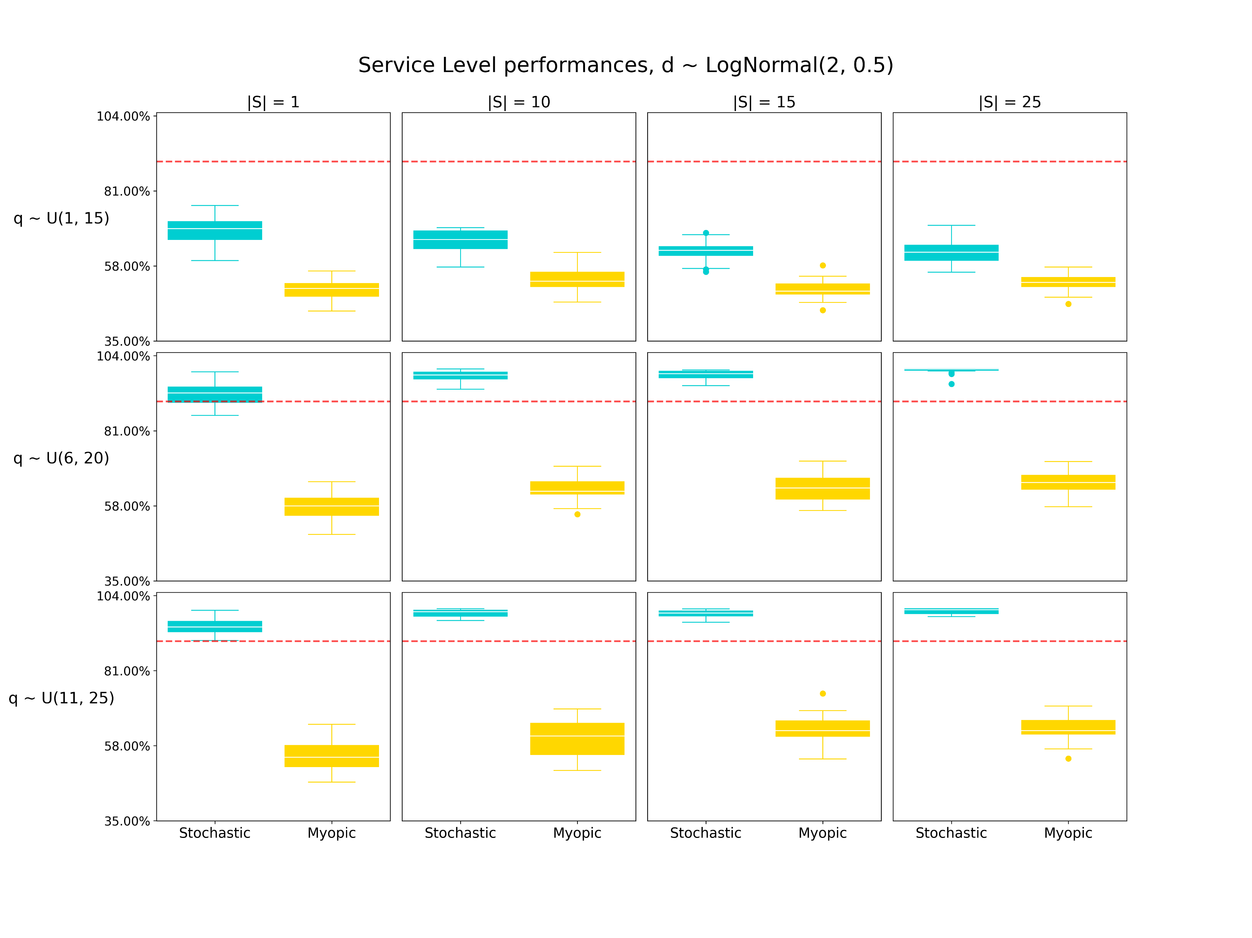
Results
Performance Metrics
Experimental design
Objective Function
Total Cost
Impact of uncertainty on decisions
Customer’s Service Level
Perished products
Computational burden
Execution time
|S|=1
|S|=10
|S|=15
|S|=25
q ~ U(1, 15)
Available Quantities of Products
q ~ U(6, 20)
q ~ U(11, 25)
14

Slide 43
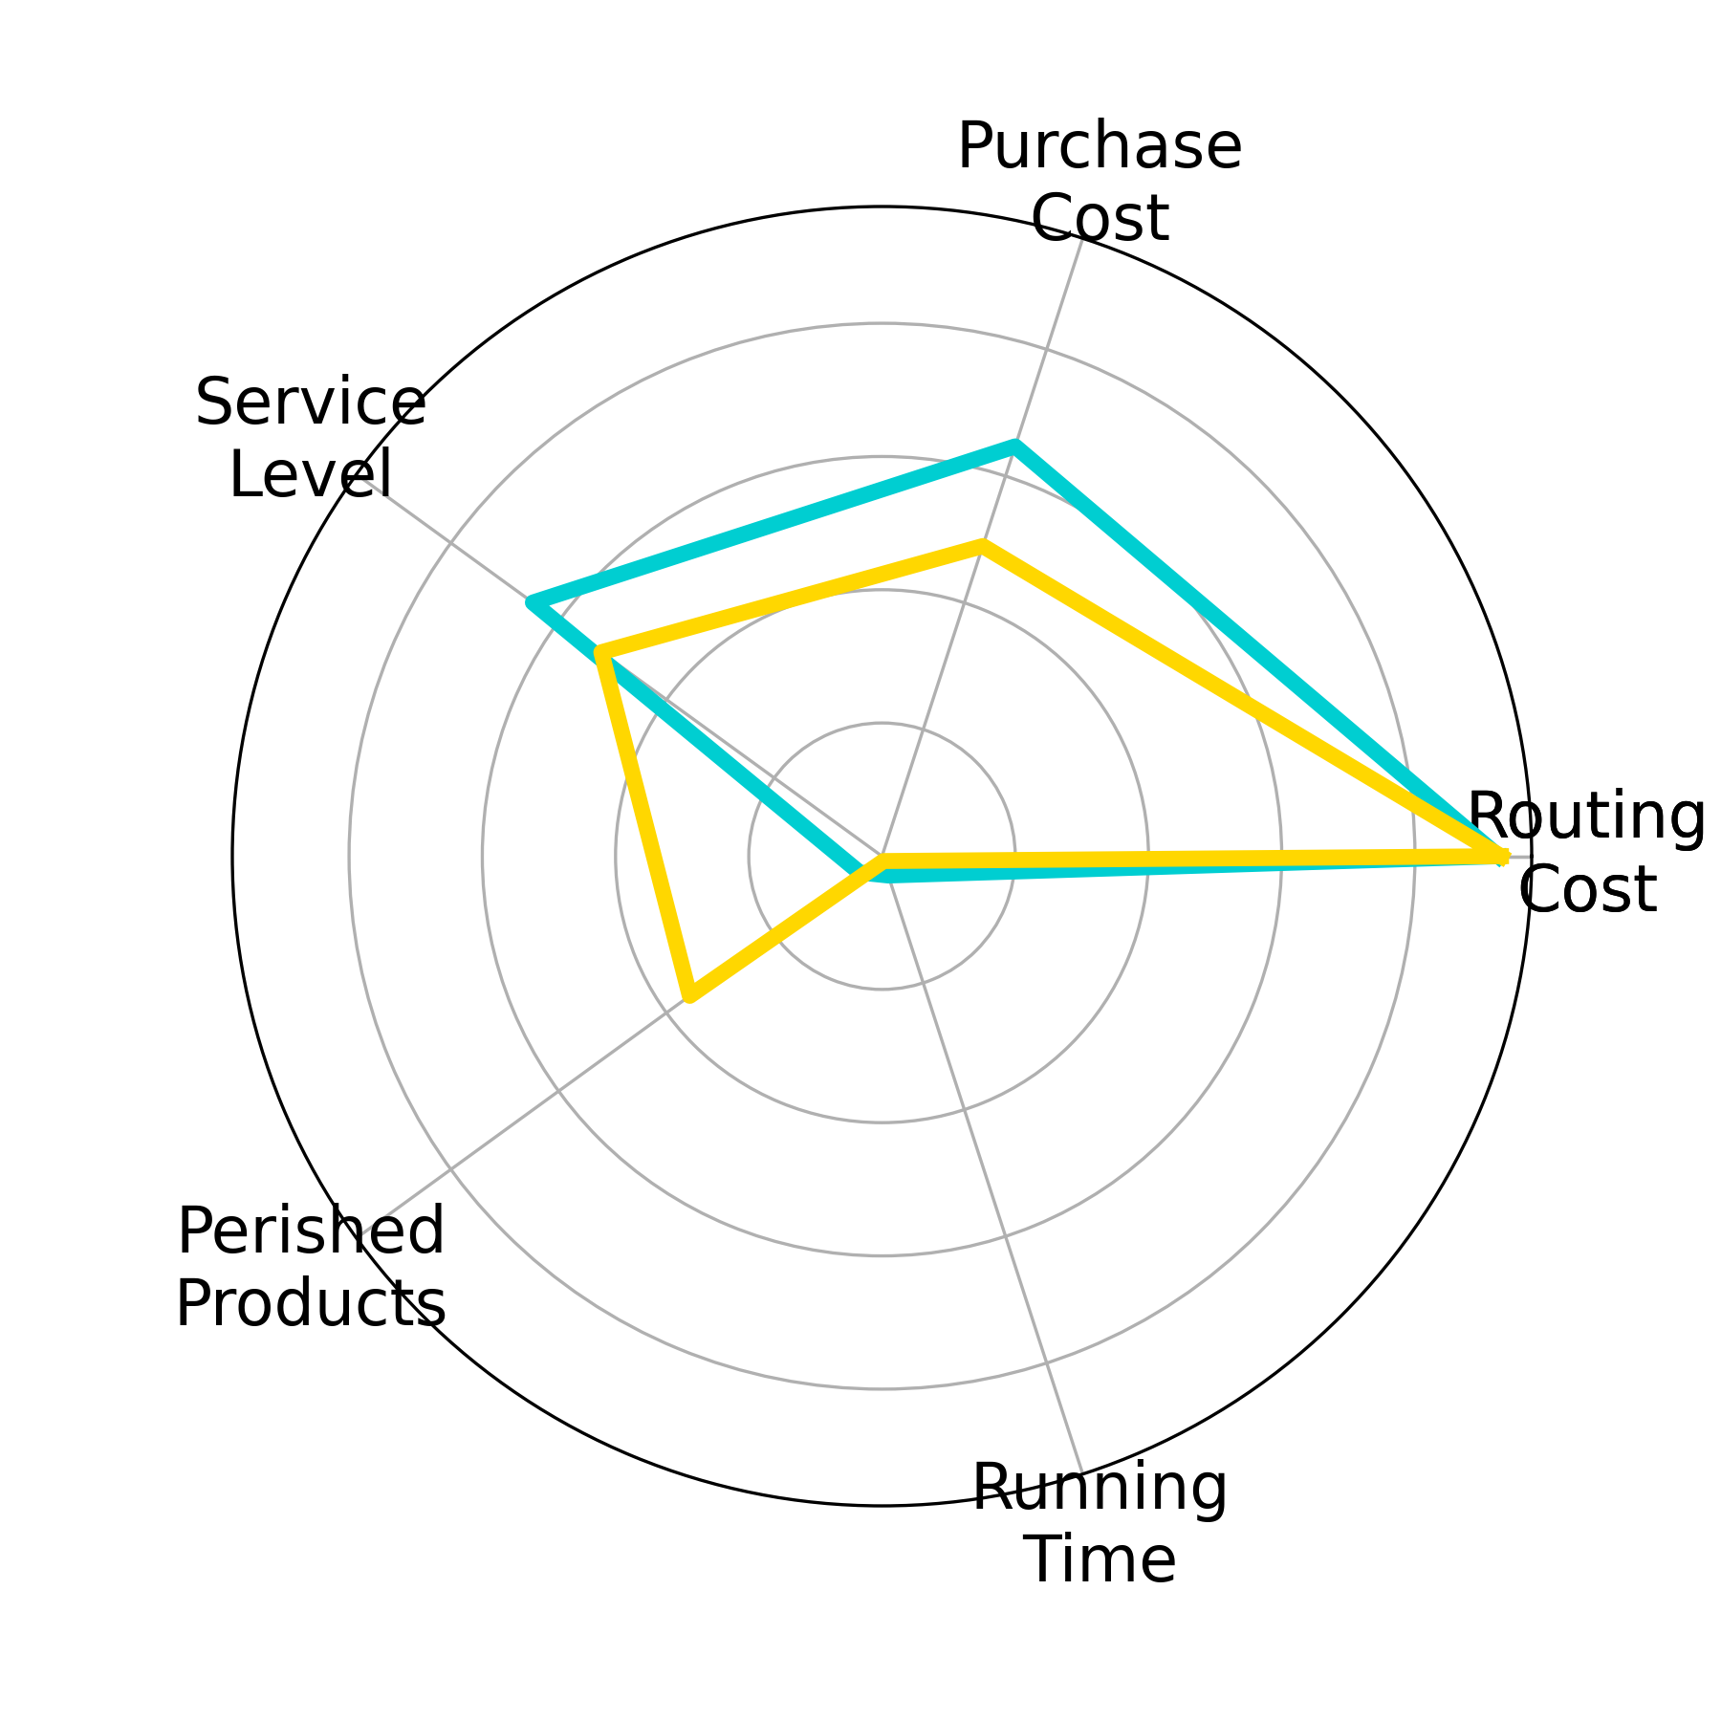
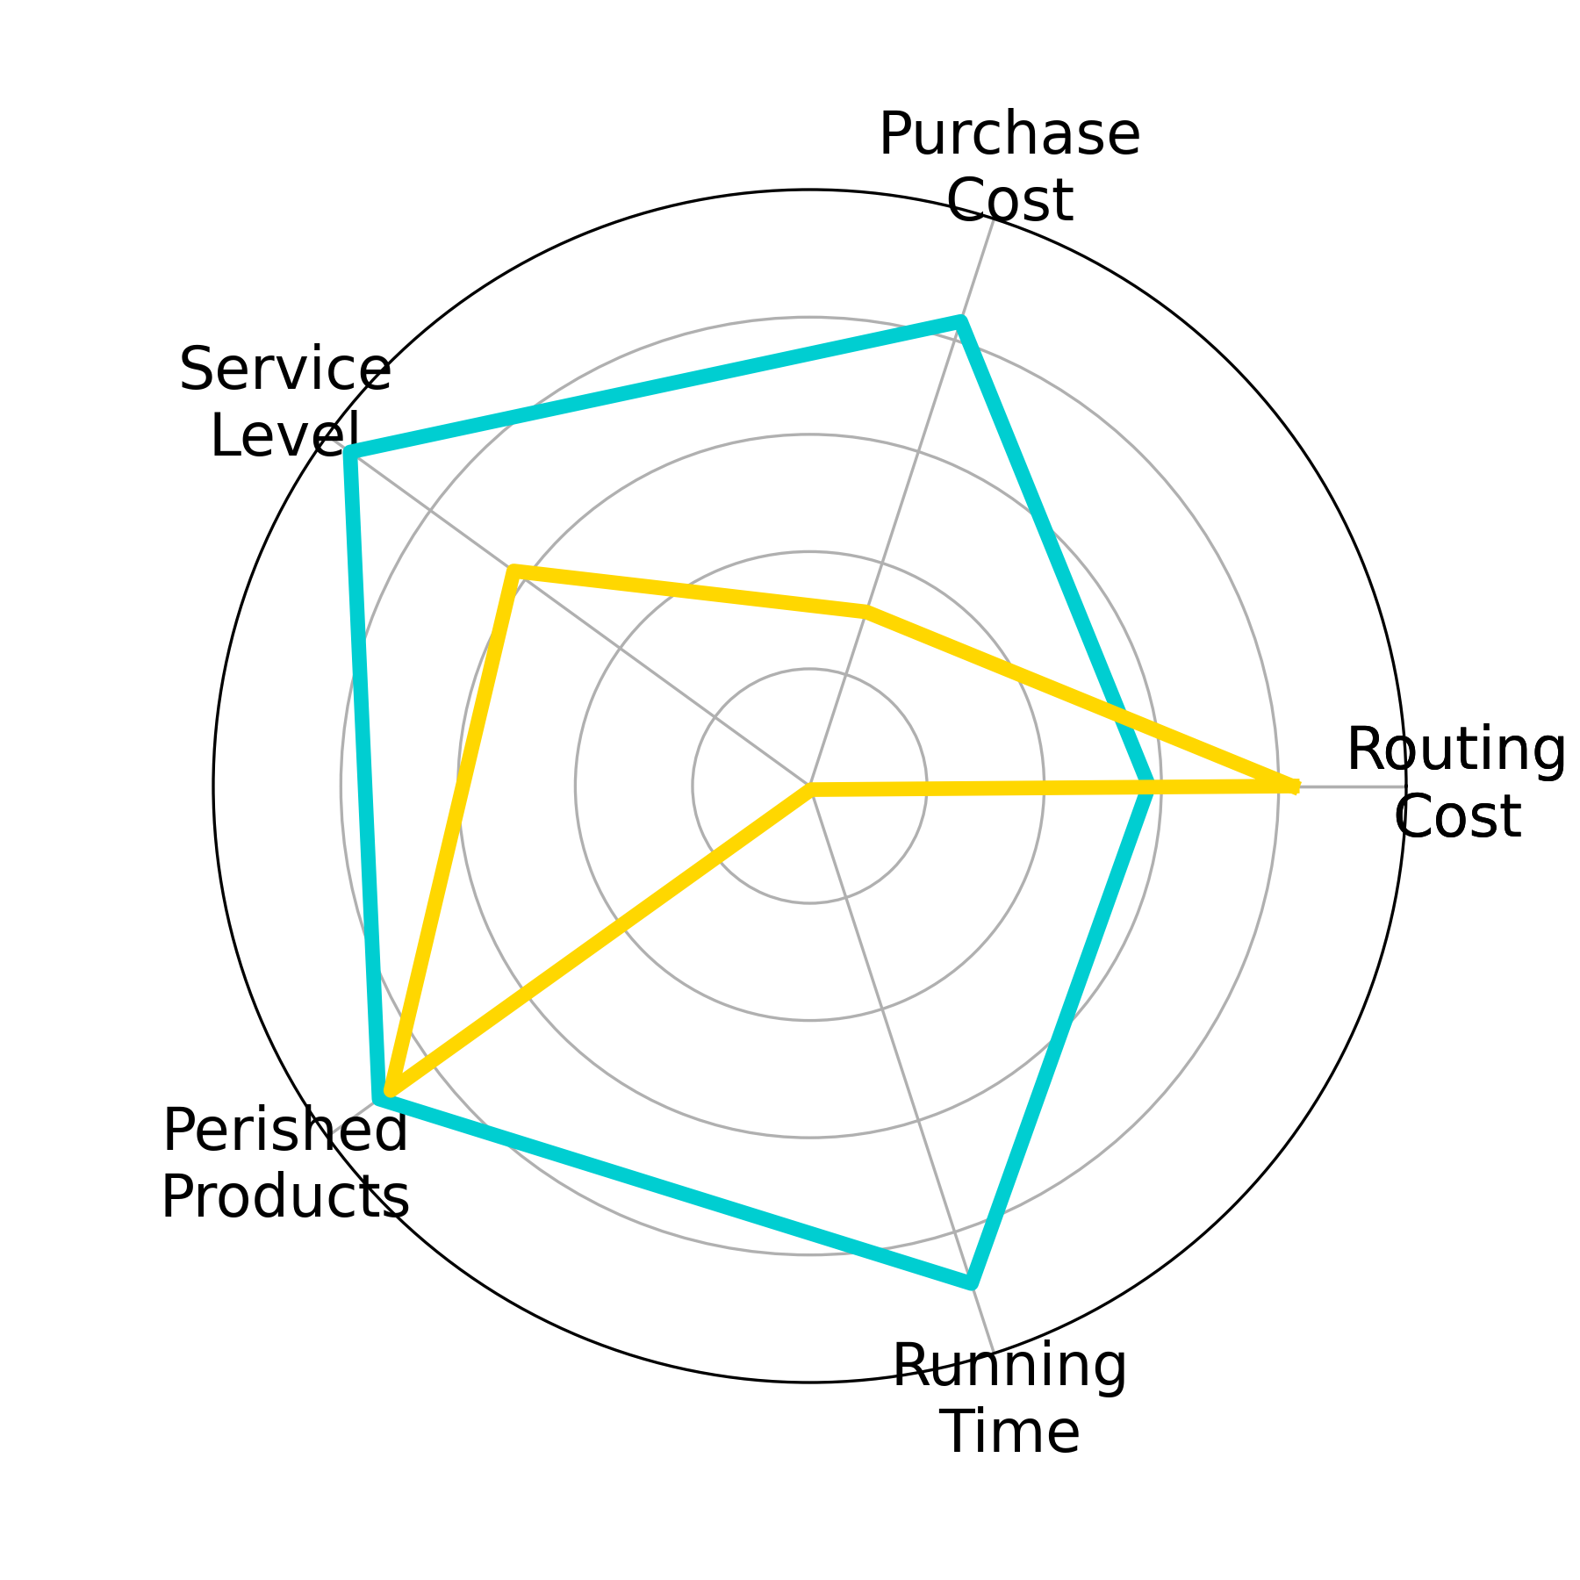
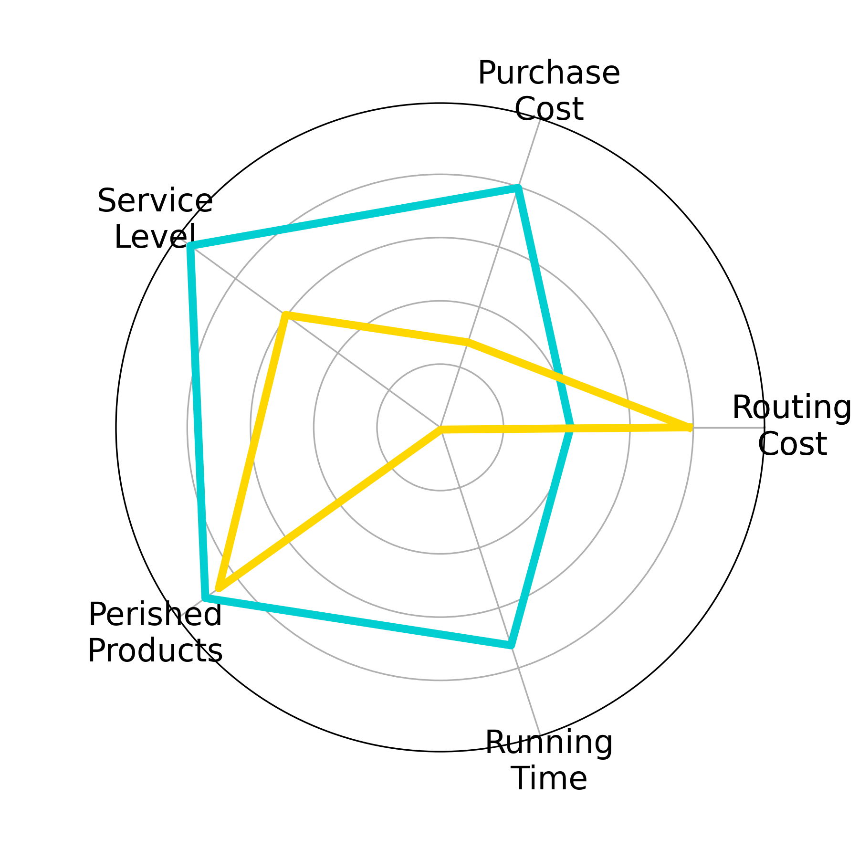
Results
Performance Metrics
Overall performance
Objective Function
Total Cost
Impact of uncertainty on decisions
Customer’s Service Level
Perished products
Computational burden
Execution time
Stochastic RH
Myopic
q ~ U(1, 15)
q ~ U(6, 20)
q ~ U(11, 25)
Available Quantities of Products
14

Slide 44
Conclusions
We implemented a computational environment to model the SD-IB-IRP-PP under the framework of sequential stochastic decisions, providing a basis for experimentation with policies based on different types of techniques.
The inclusion of a policy evaluation dashboard allows to gain insight on different key metrics from the business perspective by analyzing relevant features of what different policies achieve.
The proposed proof of concept evidences the potential of the proposed environment and policy evaluation scheme by comparing basic deterministic and stochastic policies
The capacity to anticipate future stochastic behavior has a positive impact in decision making but further effort are necessary to make efficient and scalable in practice
15

Slide 45
Future work
Enhance the instance generator with more realistic capabilities (perishability, stochasticity in other parameters)
Run a battery of experiments for policies based on math-heuristic approaches
Upgrade the environment to allow for data-driven instance generation based on real data
16

Slide 46
Ever since ASOCIO
Technical improvements on the environment coding
Incorporate diverse methodologies to face combinatorial burden of the routing problem
Value function approximation
Reinforcement-learning based goodness parameter calibration
3. Designing business-oriented scheme to provide software as a service
16

Slide 47


Centro para la Optimización y la Probabilidad Aplicada
COPA
Thank you!
17

